Slide 1
2025 Employee Benefits
Qualified High Deductible Health Plan (QHDHP) with Health Savings Account (HSA)
Notes:
Muhlenberg College is pleased to continue offering the QHDHP with HSA as a medical plan option for 2025. During today’s presentation, we will review the QHDHP with HSA plan design as well as the rules & regulations around health savings accounts (HSAs)

Slide 2
Qualified High Deductible Health Plan (QHDHP)
A QHDHP does not pay medical or prescription benefits until the plan’s deductible is met for that plan year.
However, preventive care services are still covered at 100% (based on the CBC preventive care schedule).
A QHDHP is a Health Savings Account (HSA)-compatible health plan with annual deductibles and out-of-pocket limits that comply with IRS requirements. The IRS adjusts the limits each year for inflation.
Notes:
So what is a Qualified High Deductible Health plan (or QHDHP)? A qualified high deductible health plan or QHDHP is a plan that is compatible with a Health Savings Account (HSA) based on annual deductibles and out of pocket limits that comply with IRS requirements. The IRS adjusts these limits each year for inflation.
A QHDHP cannot pay benefits until the plan’s deductible has been met for the plan year (which is the calendar year). An exception applies for preventive care services that can be paid without being subject to the deductible (preventive care is available based on the CBC preventive care schedule).

Slide 3
Qualified High Deductible Health Plan (QHDHP)
  In a QHDHP, you pay the full negotiated rate for in-network provider charges/prescriptions.
  All paid expenses apply to the deductible (both medical & prescription) until the deductible is satisfied.
    For example: You go to your primary care physician (“PCP”) because you are ill. The negotiated rate that Capital Blue Cross has for an office visit with the PCP is $125. You pay the full $125 for the visit and it will apply to your deductible (if your deductible has not been met). You then go to the pharmacy to pickup an antibiotic for your illness; the charge for that antibiotic is $65; you will pay the full $65 for the prescription, and it will apply to your deductible (if your deductible has not been met).
  After the deductible is met, 20%-member coinsurance applies to all services (until the out-of-pocket maximum is met).
  2025 maximum out-of-pocket limits:
    $6,000 individual & $12,000 family
Notes:
In a QHDHP, you pay the full negotiated rate for in-network provider changes/prescriptions until the deductible has been met.
All expenses apply to the deductible (both medical & rx) until the deductible is satisfied.
We’ve included an example (for illustration purposes only, this is not reflective of an actual visit cost).
Remember, in a QHDHP ALL expenses are applied to the deductible (both medical & prescription drug) until the deductible is met. This is unlike a traditional PPO plan where copays generally apply for services.
In a QHDHP this means that you will pay the negotiated rate for the provider charge / prescription until the deductible is met. Negotiated rates will vary by provider based on the contracted rates they have negotiated with CBC. The search and save tool available on the CBC member website is a great tool to utilize to compare the cost of service before seeking treatment. You can also compare the cost of prescription drugs by visiting express-scripts.com. We will share additional information later in this presentation about the medical & pharmacy cost comparison tools.

Slide 4
QHDHP w/HSA
When considering whether to enroll in the PPO plan or the QHDHP with HSA, consider some of the following points:
  QHDHP
    Higher up front costs for medical & prescription services
    Lower premiums
    Triple tax savings
    Additional way to potentially save for retirement
    May be a good option for those individuals who don’t have a lot of anticipated medical and prescription drug expenses
  PPO:
    Lower up front costs for medical & prescription services
    Higher premiums
Notes:
While we cannot recommend which plan is best for you, as you listen to this presentation think about some of the following items:
The QHDHP w/HSA is a quality plan that could be the right choice for man employees, depending on their unique individual circumstances.
When considering which plan to enroll in, consider some of the following things about the QHDHP w/HSA (we will review these items in more detail throughout this presentation):
- Are you able to pay higher up from costs for services (for a lower payroll contribution)? Keep in mind that this includes medical & prescription drug expenses.
- Would you like to take advantage of the tripe tax savings that an HSA provides?
Do you have a lot of medical & prescription expenses? If you do not have a lot of expenses and see your provider for annual preventive care, the QHDHP with HSA may be a good choice for you.

Slide 5
QHDHP Medical Plan Highlights
QHDHP: the deductible is combined to include medical & prescription drug costs for in-network providers. **The out-of-pocket max. includes deductible, all eligible medical & prescription drug copays & coinsurance amounts.
 | Capital Blue Cross QHDHP w/HSA (In-Network benefits illustrated)
Annual Deductible | $3,500 per individual $7,000 per family
Embedded Deductible | The amount paid by each member towards the family deductible are limited to the amount of each member’s individual deductible.
Annual Out-of-Pocket Maximum** | $6,000 per individual $12,000 per family
Plan Coinsurance (member) | 20% after deductible
Office Visit | 20% after deductible
Lab & X-ray | 20% after deductible
Inpatient Hospital | 20% after deductible
Emergency Room | 20% after deductible
Preventive Care (following the CBC preventive care schedule) is covered at 100% at In-Network providers; the deductible is waived.
Notes:
In-Network Benefits: The QHDHP has a $3,500 deductible per individual or $7,000 per family per year (calendar year). This is an embedded deductible meaning that once a member has met their individual deductible of $3,500 their services are covered by the plan at 80% (20% member responsibility). After a full family meets the $7,000 deductible, expenses are covered by the plan at 80%. If you reach the annual out of pocket limit of $6,000 per individual or $12,000 for a family, services are covered at 100% for the remainder of the plan year.
Preventive care services (as outlined on the CBC preventive care schedule) are covered at 100% at in-network providers and are not subject to the deductible.
Please keep in mind that if you go for a preventive visit and discuss medical concerns that you may be experiencing with your provider, the provider may code the visit as a diagnostic visit (as opposed to a preventive visit) and therefore the visit will be subject to the deductible (if not already) met and coinsurance (if the deductible has been met). When being seen for a preventive visit be sure to make it clear to your provider that you wish to be seen for a preventive visit.

Slide 6
QHDHP Rx Highlights
 | Prescription benefits through Express Scripts, administered by RxBenefits | Prescription benefits through Express Scripts, administered by RxBenefits
Rx Deductible | Combined with medical deductible | Combined with medical deductible
Retail Prescription Drugs (31-day supply)
Generic |  | 20% after deductible
Preferred Brand Name |  | 20% after deductible
Non-Preferred Brand Name |  | 20% after deductible
Mail-Order Prescriptions (90-day supply)
Mandatory for Maintenance Rx? |  | One original fill plus two refills are covered at retail. Subsequent refills are covered through mail order only.
Generic |  | 20% after deductible
Preferred Brand Name |  | 20% after deductible
Non Preferred Brand Name |  | 20% after deductible
Preferred Specialty (31-day supply) obtained through Accredo
Preferred Specialty |  | 20% after deductible
Notes:
The prescription plan deductible is combined with the medical plan deductible. Rx expenses that you incur will apply to the deductible along with your medical expenses. All prescriptions are subject to the deductible until the deductible is met. When the deductible is met, you will pay 20% of the cost of the prescription (until the out-of-pocket maximum is met).
If you have not met your deductible, you will pay the discounted/negotiated rate that ESI has established with the pharmacy for your medication. If you’ve previously enrolled in the PPO plan this is going to be different as you will no longer have a flat/set copay for your medication. Please keep this in mind if you are utilizing high-cost drugs.

Slide 7
CBC MyCare Finder
The MyCare Finder tool available on the Capital Blue Cross member portal will allow you to search for in-network providers.
The tool also allows you to compare costs of the services that you need; which will allow you to make an informed decision on where to seek care.
  As a reminder – the cost of service can vary greatly by provider depending on the provider’s negotiated contract with CBC. Make the most of your dollars by using the tool to find high quality, lower cost providers.
Log in to your account at CapBlueCross.com/finder to access the cost comparison tool
Notes:
The costs of services may vary greatly by provider depending on their negotiated contract with CBC. To compare costs of service before seeking service, utilize the BCC MyCare Finder tool available through the CBC member portal. Utilizing this tool may allow you to utilize a quality provider at a lower cost.

Slide 8
Prescription Cost Tool
By visiting www.express-scripts.com and logging in to your member account (or creating a new account if you do not already have one) you can review the cost of your prescription drug(s) before filling your prescription.
  The cost of prescriptions may vary by pharmacy (retail vs. mail order)
  Make the most of your plan by reviewing costs in advance (as a reminder, you will pay the full cost of the prescription drug until your annual deductible has been met).
You may also contact RxBenefits Member Services at 1-800-334-8134 for assistance with reviewing your specific drug coverage.

Slide 9
Which Is The Better Plan?
We cannot recommend or choose a plan for you.
Here are some points to consider when selecting your medical plan for 2025:
 | QHDHP w/HSA | PPO Plan
Which plan is better? | Both are quality plans. It just depends on your financial point of view, medical needs and long-term financial goals and objectives. Both plans provide comprehensive coverage and include an out-of-pocket maximum (though the amount varies based on plan selection).
Would you rather pay more money as you incur services or pay more each pay period? | Lower premiums = least amount of money out of your paycheck. You will pay more when you incur services. | Higher premiums = most money out of your paycheck. You will pay set copays for many services.
Do you take expensive or several prescription drugs? | If yes, are you comfortable with paying 100% of the cost up to your deductible then the applicable coinsurance up to the out-of-pocket maximum? | There are set copays per prescription type and the copays do not apply to your deductible.
Are you looking for a tax advantaged savings method? | If yes, this plan allows you & the College to set aside money in an HSA that you can use for healthcare expenses now or during retirement. | This plan does not provide access to any special accounts like an HSA.
Are you covering a dependent on the medical coverage? | If yes, are you comfortable with the family deductible and OOPM? | If yes, this plan has a separate deductible and OOPM per person – it is not on an aggregate basis.

Slide 10
Health savings account (HSA)
Notes:
Next, we will review the Health Savings Account (or HSA) component of the plan.

Slide 11
Health Savings Account (HSA)
If you enroll in the Qualified High Deductible Health Plan (QHDHP) for 2025, you may be eligible to make/receive HSA contributions.
What is a Health Savings Account (HSA)?
A health savings account (HSA) is an account that you can use to pay qualified medical expenses.
  This account helps offset your medical costs by giving you tax advantages, allowing your income to stretch farther by using the dollars that would have otherwise been paid in taxes.
BUT there are still a few rules:
  You have to be eligible to have a HSA
  You have to spend the dollars on qualified medical expenses and keep itemized receipts.
Notes:
If you enroll in the QHDHP for 2025, you maybe eligible to make and/or receive HSA contributions.
So what is a health savings account?
- a health savings account (or HSA) is a savings account that you can use to pay for qualified medical expenses. The HSA helps offset your medical costs by giving you tax advantages, allowing your income to stretch farther by using the dollars that would have otherwise been paid in taxes.
There are a few rules for HSAs
- You have to be eligible to have a HSA
- You have to spend the dollars on qualified medical expenses and keep itemized receipts.

Slide 12
Health Savings Account (HSA)
A Health Savings Account (HSA) provides a triple tax advantage.
  Contributions to the HSA are made pre-tax
  The account earns interest tax-free
  Distributions are tax free (as long as they are utilized for qualified healthcare expenses)
The account is owned by the employee
  There is no “use or lose” rule like a FSA; unused funds remain in the account until they are utilized.
When the account reaches a certain dollar threshold, investment opportunities are available.
Muhlenberg has selected P&A Group as our HSA administrator (more information about P&A Group will be provided later in this presentation).
Notes:
A Health Savings account provides a triple tax advantage
- contributions that you made to the HSA are made pre-tax
- the account earns interest tax-free
- distributions are tax free (as long as they are utilized to pay for qualified healthcare expenses)
A HSA is owned by you, the employee
- there is no “use or lose” rule like a FSA; unused funds remain in the account until they are utilized
(if you change employers or do not enroll in a QHDHP in subsequent years the account remains with you)
There are opportunities to invest the funds in your HSA when the account reaches a certain dollar threshold
Muhlenberg utilizes P&A Group as our HSA administrator (more information about P&A Group will be reviewed later in this presentation).

Slide 13


Are You Eligible for an HSA?
Are you covered on a Qualified High Deductible Health Plan? (QHDHP)
SORRY!
Unfortunately, you are not eligible for a Health Savings Account.
An HSA is a tax benefit that is heavily regulated by the IRS. There are certain requirements to be considered qualified to contribute pre-tax dollars.
You are still eligible to participate in the QHDHP, but you are not eligible to fund an HSA to pay for out-of-pocket expenses.
Have you been enrolled on Medicare, Tricare, VA or HIS non-Preventive Medical/Rx plan within the last 3 months?
Are you claimed as a dependent on another person’s tax return?
Do you (OR YOUR SPOUSE) have a Flexible Spending Account (FSA)?
Is it a Limited Purpose FSA?
CONGRATULATIONS! It appears you are eligible to make pre-tax contributions into a Health Savings Account!
Notes:
You must be eligible in order to contribute to a Health Savings Account
- the first eligibility test is that you must be enrolled in a Qualified High Deductible Health Plan
- if you have been enrolled on Medicare, Tricare, VA or HIS non-Preventive medical/rx plan within the last 3 months you are not eligible for a HSA
- if you are claimed as a dependent on another person’s tax return you are not eligible for a HSA
- if you (or your spouse) have a flexible spending account (not a limited purpose FSA) you are not eligible for a HSA
If you are not eligible for a HSA this does not mean you cannot enroll in the QHDHP, this means that you are not eligible to fund a HSA (or receive employer funds in a HSA)

Slide 14
Special Rules of Married Individuals
If married individuals both have a QHDHP with HSA, and either spouse has family coverage, both spouses are treated as having only that family coverage
  If both are HSA eligible, the HSA contribution limit is divided between spouses and cannot exceed the annual family limit
  This rule applies even if one spouse has family coverage and the other has self-only coverage
Notes:
Keep in mind that there are special rules for married individuals
If married individuals both have a QHDHP with HSA, and either spouse has family coverage, both spouses are treated as having only that family coverage.
If both are HSA eligible, the HSA contribution limit is divided between spouses and cannot exceed the annual family limit
This rule applies even if one spouse has family coverage and the other has self only coverage

Slide 15
Medicare Entitlement
Individuals entitled to Medicare are not eligible for HSA contributions;
Medicare entitlement means being both eligible and enrolled;
Individuals can contribute to their HSA as long as they are an eligible individual and have not enrolled in Medicare Parts
A, B or D;
If an Individual turns age 65, is still working, and is not enrolled in Medicare, they are still eligible to contribute to an HSA.
Notes:
Individuals entitled to Medicare are not eligible for HSA contributions – Medicare entitlement means being both eligible and enrolled
Individuals can contribute to their HSA as long as they are an eligible individual and have not enrolled in Medicare Part A, B, or D
If an individual turns age 65, but is still working and not enrolled in Medicare, they are still eligible to contribute to an HSA

Slide 16
HSA: How Much Can I Contribute?
Maximum HSA Contribution:
Individual Enrollment: $4,300
Family Enrollment: $8,550
These annual maximums include any employer contributions (annual maximums are set by the IRS).
Please remember:
  Muhlenberg will contribute $750 per year for individual enrollment and $1500 per year for all other tiers of coverage
  Those 55 years and older and not enrolled in Medicare can contribute an additional $1,000 “catch-up” each year.
Notes:
The IRS stipulates the annual HSA maximum contributions and adjusts these annually for inflation.
For 2025, those with individual enrollment may contribute a maximum of $4,300 for the calendar year. Those with family coverage may contribute a maximum of $8,550 for the calendar year. Keep in mind that the annual maximum includes any employer contributions.
For 2025., Muhlenberg will contribute $750 for those enrolled in Single coverage and $1,500 for those enrolled in non-single (family) coverage
For those individuals age 55 years and older and not enrolled in Medicare, an additional “catch-up” contribution of $1,000 may be made each year.

Slide 17
HSA: Who Can Spend the Dollars?
HSAs may reimburse any qualified health expense of the:
Account holder
(i.e. employee)
Account holder’s legal spouse
Any tax dependents
of the account holder
Non-Tax Dependents and Domestic Partners:
Expenses of non-tax dependents are not eligible for reimbursement through the account holders HSA, however if they are HSA-eligible, i.e. have no other disqualifying coverage, they can open their own HSA!
Notes:
You may use funds in your HSA to reimburse qualified health expenses of:
- the account holder (the employee)
- the account holder’s legal spouse
- any tax dependent of the account holder

Slide 18
HSA Eligible Expenses
According to IRS rules, a qualified expense must be primarily for the diagnosis, treatment or prevention of disease or illness. Refer to IRS Publication 502 for a complete list of eligible expenses.
  https://www.irs.gov/pub/irs-pdf/p502.pdf
Notes:
The IRS establishes eligible/qualified expenses via Publication 502. Qualified expenses must be primarily for the diagnosis, treatment or prevention of disease or illness.
Examples of qualified expenses are listed on the screen. Refer to Publication 502 for additional details.

Slide 19
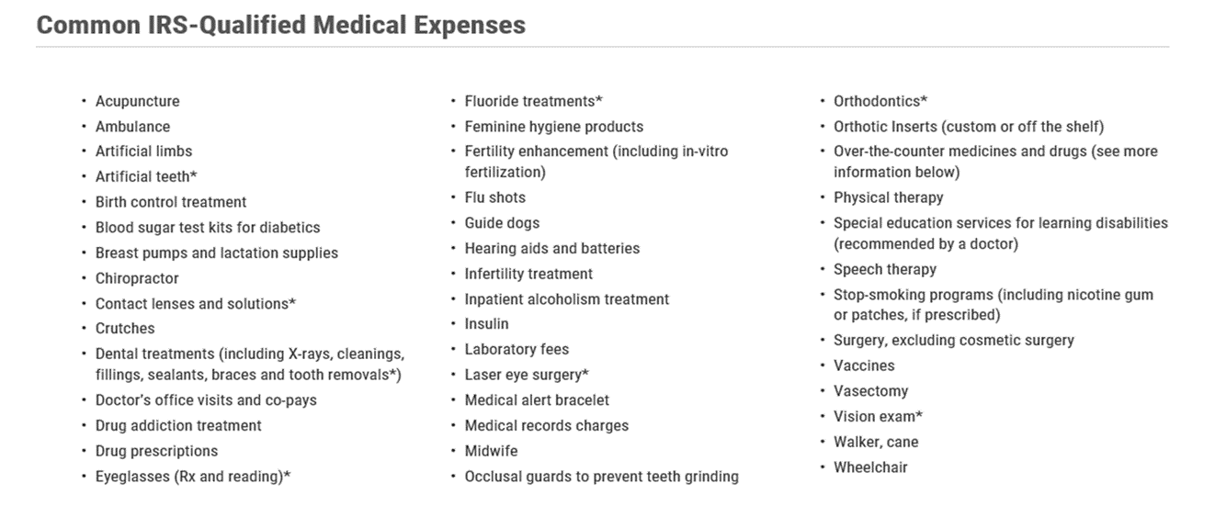
HSA Eligible Expenses
Notes:
The IRS establishes eligible/qualified expenses via Publication 502. Qualified expenses must be primarily for the diagnosis, treatment or prevention of disease or illness.
Examples of qualified expenses are listed on the screen. Refer to Publication 502 for additional details.

Slide 20
HSA: Additional Eligible Expenses
Other eligible expenses for tax-free distributions include:
  Premiums for COBRA
  Premiums for coverage while receiving unemployment compensation under State Law
  Premiums for individuals over age 65 (Medicare premiums)
Note: if you conclude employment or coverage under the QHDHP
  You cannot use the funds in the HSA to cover premiums for coverage under another employer's plan
  You can use the funds for out-of-pocket expenses such as copays and deductibles.
Notes:
There are additional expenses that qualify for tax-free HSA distribution, including:
- premiums for COBRA
- premiums for coverage while receiving unemployment compensation under state law
- premiums for individuals over age 65 (Medicare premiums)
If you terminate employment or coverage under the QHDHP (as a reminder, you cannot contribute to a HSA without medical coverage under a QHDHP)
- you cannot use the funds in the HSA to cover premiums for coverage under another employer’s plan
- you can use the funds for out-of-pocket expenses such as copays and deductibles

Slide 21
HSA: Record Checklist
You must keep records sufficient to show that:
  The distributions were exclusively to pay or reimburse qualified medical expenses
  The qualified medical expenses had not been previously paid or reimbursed from another source
  The medical expenses had not been taken as an itemized deduction in any year
  Do not send these records with your tax return. Keep them with your tax records.
Notes:
While you are not required to submit records with your tax return showing that HSA funds were spent on qualified healthcare expenses you should be sure to keep all of your receipts/records. You can electronically save copies of your receipts on your P&A Group member portal by taking a picture of the receipt and uploading.
In the event you are ever audited, the IRS may request substantiation for use of your HSA funds. If you cannot provide proof that HSA funds were spent on qualified expenses, you will owe penalties and back taxes to the IRS.
If you choose NOT to spend your HSA funds on qualified expenses, KEEP your receipts! You can reimburse yourself at a later date for expenses incurred after your HSA was established.

Slide 22
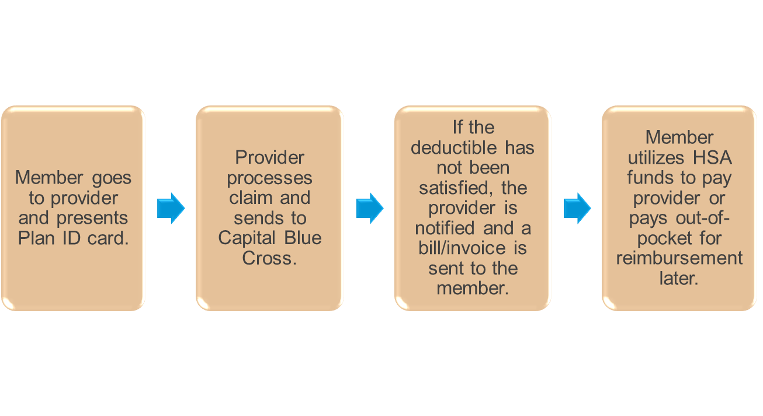
Using your HSA for a Provider Visit
Notes:
This slides illustrates an example of an in-network provider visit & how you can utilize HSA funds to pay for the visit.
When you go to the provider you will present your CBC member identification card.
The provider is going to submit the claim for your visit to Capital Blue Cross on your behalf.
When CBC has processed the claim, they will send you as well as your provider an Explanation of Benefits (EOB). If you have not met your deductible, the provider will bill you the negotiated rate for the service based on the CBC EOB. If your deductible has been made, you will be billed for 20% coinsurance for your visit.
You can choose to utilize funds from your HSA to pay the provider for your visit, or you can save your HSA funds and pay for the visit out of your banking account. (remember to save the receipts/EOBs in either instance)

Slide 23
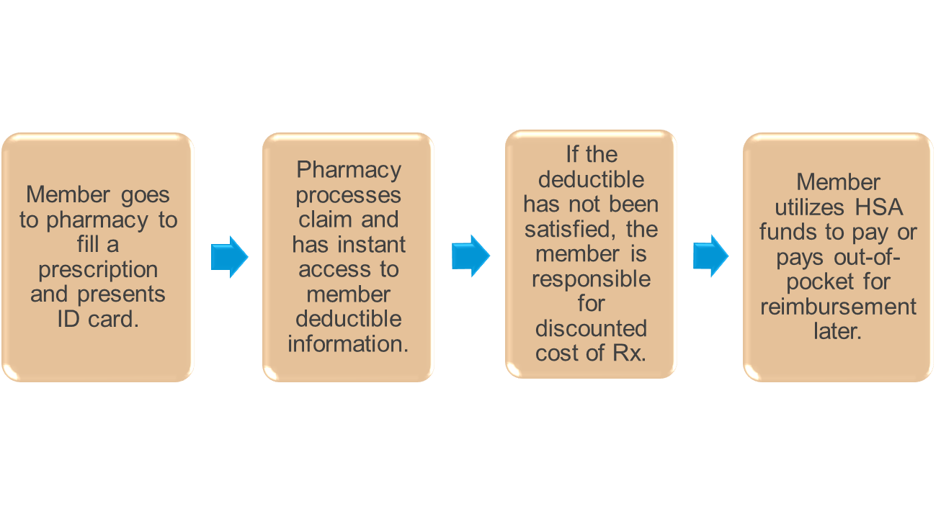
Using your HSA for Prescription Drugs
Notes:
When you go to the pharmacy to fill a prescription the billing process will be a little bit different.
You will present your CBC member ID card to the pharmacy when filling a script.
The pharmacy will process the claim and have instant access to your deductible information. If the deductible has not been satisfied, you will pay the negotiated rate for the drug (which will apply to your deductible). If your deductible has been met, you will pay 20% of the negotiated rate for the drug.
You can utilize HSA funds to pay for the drug, or pay out of pocket and save your receipt. Save your receipts either way!

Slide 24
P&A Group
P&A Group is the Health Savings Account administrator
  A Health Savings Account (HSA) is an individual banking account. Once you apply for a HSA and before your account can be opened, P&A will need to confirm your full name, residential mailing address, date of birth, and social security number as required by the USA Patriot Act. This process is called the Customer Identification Program or CIP.
  Muhlenberg College will submit your enrollment information to P&A Group. P&A Group will reach out to you directly if you did not pass the CIP and additional information is needed.
    Be sure to respond promptly if P&A Group reaches out to you for additional information to open your HSA.
Notes:
P&A Group is the HSA administrator
A Health Savings account is an individual banking account. If this is the first time that you are applying for a HSA through P&A, they will need to confirm your full name, residential mailing address, birth date and social security number as required by the USA Patriot Act. This process is call the Consumer Identification Program or CIP.
Muhlenberg College will submit your enrollment information to P&A. P&A will reach out to you directly if you do not pass the CIP and additional information is needed. Be sure to promptly respond if P&A reaches out for additional information.

Slide 25

P&A Group
After your account has been opened, you will receive a HSA debit card from P&A Group. You can use this card to pay for qualifying expenses at the point of sale (be sure to keep your receipts as previously discussed).
  If you were enrolled in the HSA last year, you will NOT receive a new HSA debit card each year; you should continue to utilize your current HSA debit card (P&A will mail a new debit card in advance of expiration of your current card)
You can order additional debit cards for your spouse and eligible dependents on the P&A website.
If you are not able to pay a provider utilizing the HSA debit card, you can pay the provider directly from your account via the P&A portal or you can reimburse yourself if you paid for the service out of pocket.
Notes:
After you HSA is opened, you will receive a HSA debit card from P&A. This card to be utilized to pay for qualifying expenses at the point of sale (reminder, keep all receipts when utilizing your debit card)
If you were enrolled in the HSA at Muhlenberg College in 2024 please keep in mind that you will not receive a new HSA debit card each year. You should continue to utilize your current HSA debit card. P&A will only mail you a new card if your card is set to expire (or if you request a new card).
You can order additional or replacement debit cards through the P&A website.
If you are unable to use your debit card to pay a provider, you can reimburse yourself from your HSA account via the P&A portal.

Slide 26
P&A Group
Tax Reporting
  IRS form 8889 must be completed with your tax return each year to report total deposits and withdrawals from your account. You do not have to itemize to complete this form.
Investment Accounts
  Once your HSA balance reaches $1,000, you can transfer funds to an HSA investment account. Information is available on the P&A member portal about investment account options.
Beneficiaries
  Be sure to access your account to designate beneficiaries.
Notes:
A few additional items to keep in mind about HSAs:
The IRS form 8889 must be completed with your tax return each year to report total deposits and withdrawals from your account (P&A will provide you with the documentation that you need for the tax filing)
Once your HSA balance reaches $1,000, you can transfer funds to an HSA investment account. Information is available on the P&A member portal about investment accounts.
Be sure you designate beneficiaries for your HSA account. This can be done on the P&A member portal.

Slide 27
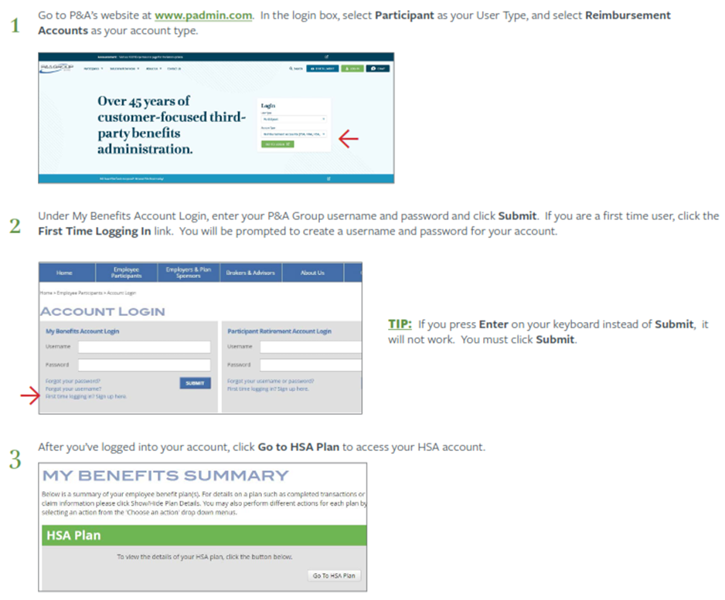
P&A Group Participant Support Center & Member Portal
www.padmin.com
Phone: 716-852-2611
Hours: Monday – Friday 8:30 am – 10:00 pm EST
Notes:
The P&A member portal is available at www.padmin.com
Member services is available by calling 716-852-2611 Monday – Friday 8:30 am – 10:00 pm EST

Slide 28
Thank you!!

